Slide 1
Group 14 AI Coursework 2 (Group Task)
Authors:
Ali, Hasan
Hussain, Jumail
Mahmood, Abdul-Wahab
Shimizu Felisberto, Matheus
Zhang, Yufei

Slide 2
Roles:
Iterative Deepening: Jumail
Uniform Cost: Matheus and Abdul-Wahab
Best-First: Hasan and Yufei

Slide 3
Iterative Deepening: Implementation
Iterative deepening depth-first search is a state space/graph searching strategy in which a limited version of the DFS is run over and over again while increasing the depth limits until the eventual goal is found. The search start is just as optimal as breadth-first search, however it uses less memory and at every iteration, each node within the search tree is visited the same as DFS, but the increasing order is which the nodes are visited one by one is breadth-first as its most effective.

Slide 4
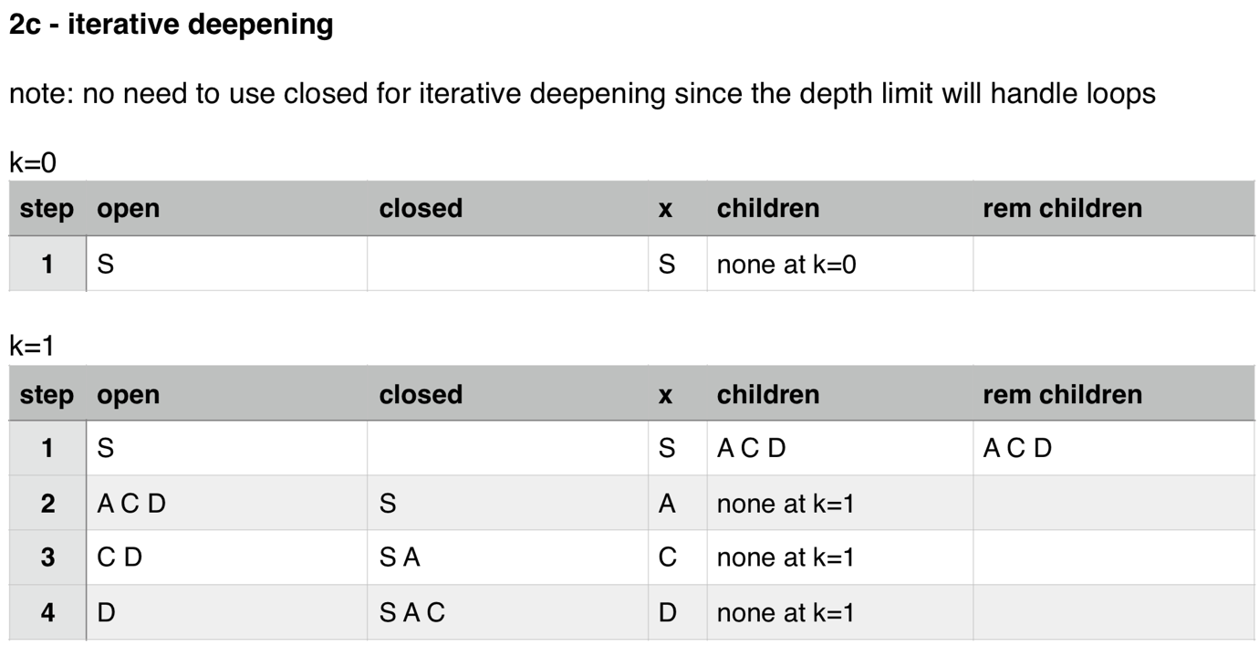
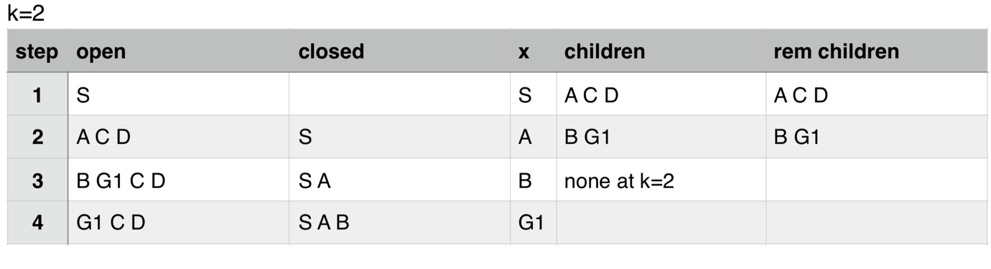
Iterative Deepening: Results

Slide 5
Iterative Deepening: Analysis

Slide 6
Uniform Cost: Implementation
Uniform cost is considered the best search algorithm that doesn’t involve a heuristic method type. It demands the use of priority queues, such as DFS(Depth-first Search) and BFS(Breadth-first Search). Matheus and Abdul have chosen to use a open stream reader in order to read the nodes and give the corresponding result.

Slide 7
Uniform Cost: Results
Insert code results

Slide 8
Uniform Cost: Analysis

Slide 9
Best-First: Implementation
Best first searches the node for the lowest value until its searches the last node of the branch, it will continue the search until it has found the node it is looking for. In our implementation it starts from the node ‘S’ and finishes at the node ‘G1’. From the tree diagram it will search for the lowest node which in this case is ‘C’ it will then continue the search and move down a branch and search for the next value which will be ‘J’ the next node will be ‘G1’ as the cost is 0 and so the program will stop as it has found the node.

Slide 10
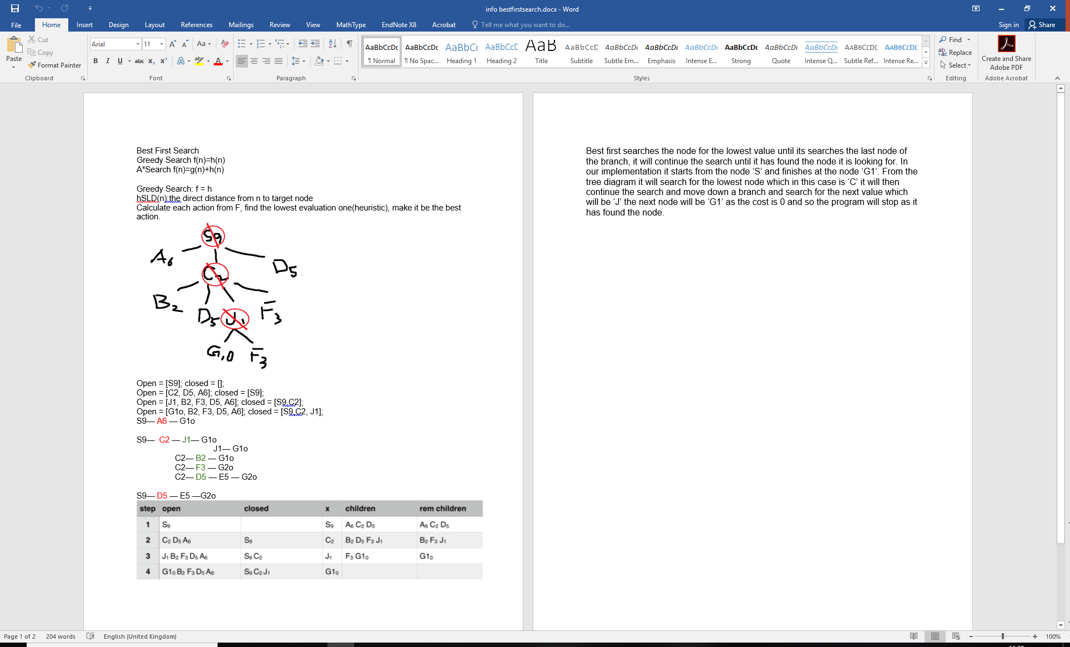
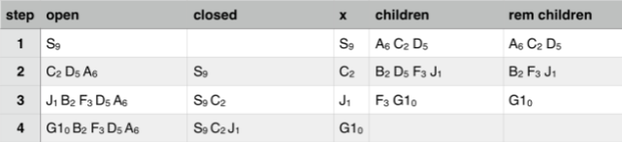
Best-First: Results

Slide 11
Best-First: Analysis

Slide 12
Evidence of Group Work
Initially we set up a WhatsApp group chat to discuss the time and whereabouts of the meetings. He agreement came to Thursdays from 11:00 til 12:00 and Fridays 12:00 til 1:00. We had 4 group meetings in total where strategies, implementation and any code related discussion took place.
During the first group meeting, a GitHub repository was also set up so we could share our code and work so we could all work on the tasks in our spare time to make the most of our time and ensure the deadline would be met.

Slide 13
The End
Questions?

